Slide 1
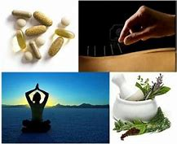
Complementary and Alternative Medicine
(CAM)

Slide 2
Learning Objectives
Define Complementary Medicine
Define Alternative Medicine
Define Integrative Medicine
Describe various common methods
Demonstrate guided relaxation technique

Slide 3
Defining Complementary and Alternative Medicine
(WebMD accessed on 6.21.19 from https://www.webmd.com/balance/guide/complementary-vs-alternative-medicine#1 )
Many people take “complementary medicine” and “alternative medicine” to mean the same thing. And, although they are often grouped together under the umbrella of CAM (complementary and alternative medicine), they’re actually different.
Both terms refer to treatments, like herbs or acupuncture that are out of the medical mainstream. But complementary medicine is when these therapies are used along with traditional Western medicine. Alternative medicine is when these approaches are used instead of traditional medicine.
Examples of non-mainstream medicine include yoga, chiropractic medicine, meditation, and massage therapy.
Few people use alternative medicine, and experts recommend against it. But more and more traditional doctors are accepting complementary medicine. In many cases, the two health systems actually overlap. For instance, many traditional medical doctors also practice acupuncture. And many major medical centers offer complementary approaches. Some of them are even covered by insurance.
Who Can Benefit from CAM?
In theory, anyone. It doesn’t matter if they’re sick or healthy. Every person will respond differently to each product or practice. It’s also important to know that some complementary approaches have been studied more than others.

Slide 4
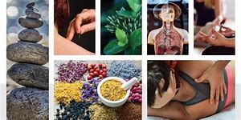
Defining Integrative Medicine
In recent decades, a medical approach known as integrative medicine has become more widely practiced in the U.S. and other countries. Integrative medicine involves combining treatments from conventional medicine with forms of complementary and alternative medicine whose use is supported by high-quality evidence for their safety and effectiveness.
As the National Center for Complementary and Integrative Health (NCCIH) points out, scientists are presently looking at the possible benefits of integrative medicine in a range of circumstances, such as pain management for military personnel and relief of symptoms in cancer patients.
(https://www.verywellhealth.com/alternative-vs-complementary-medicine-88731)

Slide 5
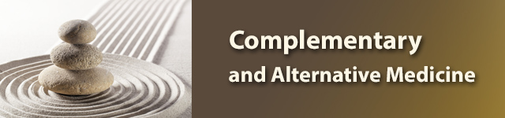
Classifications
The National Center for Complementary and Integrative Health (NCCIH) classifies most complementary health approaches into one of two subgroups:
  1) natural products, including herbs, vitamins, minerals, and probiotics, often sold to consumers as dietary supplements; or
  2) mind and body practices including a large and diverse group of procedures or techniques administered or taught by a trained practitioner or teacher. These include but are not limited to
    Movement Therapies: Yoga, tai chi, qi gong
    chiropractic and osteopathic manipulation
    Meditation and relaxation
    massage therapy
    acupuncture
    healing touch
    Herbs and supplements
  Other complementary health approaches include traditional healers, Ayurvedic medicine, traditional Chinese medicine, homeopathy and naturopathy.
https://www.nlm.nih.gov/tsd/acquisitions/cdm/subjects24.html

Slide 6

Watch: Complementary and alternative medicine: France's parallel healthcare system
https://www.youtube.com/watch?v=-56hZxOKpI0
11 minutes
Students take a piece of paper and draw columns. During the video, take notes on:
  What is new information?
  What is confusing information?
  What information you already know?
Class discussion follows the video
  What is new information?
  What is confusing information?
  What information did you already know?
  How will you use the information?

Slide 7
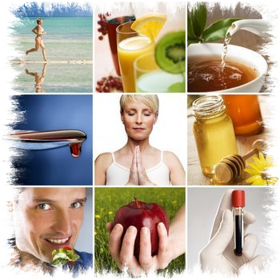
A note
Because we all respond differently to the many complementary and alternative medicines and techniques, and because there still is much research that needs to occur on the effectiveness of each technique, it is best to check with your physician, nurse practitioner or other primary care provider if you are ill and want to integrate CAM into your healing process.

Slide 8
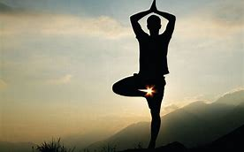
Movement Therapies: Yoga, Tai chi, Qigong
Yoga. Yoga uses breathing exercises, mediation, and poses to stretch and flex different muscle groups. Yoga has been found to help regulate stress hormones and improve mood and physical well-being. It can also reduce pain, fatigue, nausea, sleep problems, and inflammation.
  Watch: Yoga at Your Desk and practice! https://www.youtube.com/watch?v=tAUf7aajBWE 6 minutes
  How do you feel?
Tai chi and qigong. Tai chi and qigong combine a series of fluid movements with slow, regulated breathing. These mind-body practices have been found to improve quality of life, reduce sleep problems, and decrease inflammation.
  Watch: The Physiology of Tai Chi and Qigong
  https://www.youtube.com/watch?v=ZJRtZAwVwgo 12 minutes
  Impressions?

Slide 9
Osteopathic and Chiropractic medicine
Chiropractors and osteopaths are both medical professionals who treat patients with a focus on the musculoskeletal system, including the spine, joints, muscles, tendons, and ligaments. The two professions are actually radically different, requiring different levels of certification and ultimately offering different services. There has also been some historical hostility between the two fields, which can make sorting out the differences rather challenging. Essentially, both offer valuable and useful services, and each can be included in a holistic healthcare regimen.
A chiropractor is a medical professional trained in chiropractic medicine, typically in a three to four year program. The student learns about anatomy, physiology, and biology, and focuses on the skeletal system. Chiropractic doctors believe that many health problems are related to imbalances in the musculoskeletal system, and they learn to perform small adjustments to this system while in school.
  https://www.wisegeek.com/what-is-the-difference-between-an-osteopath-and-a-chiropractor.htm
Watch London Osteopath: What's The Difference Between An Osteopath and a Chiropractor: https://www.youtube.com/watch?v=0TCFL3kgirQ 4 minutes
Any experiences in the classroom?

Slide 10

Meditation
The beauty of practicing meditation is that it allows you to “let go” of every day worries and literally “live in the moment.” People who meditate regularly report improvements physically, mentally, and spiritually. To begin a meditation practice, you will need to find a quiet spot, away from the phone, television, friends, family, and other distractions.
There are several different ways to meditate. Meditation practices often involve learning chanting, breathing, or mantra techniques.
Initially, your mind may wander when you first start meditating. by training your mind to focus on the moment, you will eventually find yourself transformed and feel very peaceful and content.
Most experts recommend mediating for about 20 to 30 minutes at a time. Beginners may find it difficult to meditate for this length at first. It will become easier once you are meditating regularly.

Slide 11

Relaxation Techniques – Guided Imagery
Guided Imagery is a wonderful stress reduction tool which uses “visualization” and “mental imagery” techniques to improve health.
  Practice Guided Imagery for 10 minutes: https://www.youtube.com/watch?v=ar_W4jSzOlM
How do you feel?
It has been used effectively for cancer patients who literally imagine themselves without the cancerous cells.
Other creative visualization techniques include transporting the individual to a quiet place in their mind (perhaps a favorite lake, river, or forest).
You can either create your own special place or listen to a guided imagery tape or CD. According to the Guided Imagery Resource Center, guided imagery can “reduce blood pressure, lower cholesterol and glucose levels in the blood and heighten short-term immune cell activity.”
https://psychcentral.com/lib/relaxation-and-meditation-techniques/

Slide 12
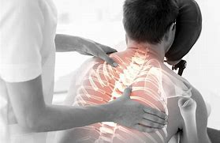
Massage Therapy https://www.webmd.com/balance/guide/massage-therapy-styles-and-health-benefits#2
Massage has been practiced for thousands of years. Today, if you need or want a massage, you can choose from about 80 massage therapy styles with a wide variety of pressures, movements, and techniques. These all involve pressing, rubbing, or manipulating muscles and other soft tissues with hands and fingers. Sometimes, even forearms, elbows, or feet are used.
According to the American Massage Therapy Association, up to 25 percent of American adults had a massage at least once during 2016-2017. And, they have a wide range of reasons for doing so. More and more people -- especially baby boomers -- recognize the health benefits of massage. They choose from among many massage styles to get relief from symptoms or to heal injuries, to help with certain health conditions, and to promote overall wellness.

Slide 13
Common Types of Massage
Deep Tissue Massage
Deep tissue massage is best for giving attention to certain painful, stiff "trouble spots" in your body. The massage therapist uses slow, deliberate strokes that focus pressure on layers of muscles, tendons, or other tissues deep under your skin. Though less rhythmic than other types of massage, deep tissue massage may be therapeutic -- relieving chronic patterns of tension and helping with muscle injuries, such as back sprain.
Sports Massage
Developed to help with muscle systems used for a particular sport, sports massage uses a variety of approaches to help athletes in training -- before, during, or after sports events. You might use it to promote flexibility and help prevent injuries. Or, it may help muscle strains, aiding healing after a sports injury.
Chair Massage
Ever gone to a county fair, music festival, or conference and envied other people getting chair massages? Passed by the chair massage section in an airport? Or, maybe you're lucky enough to work at a company that offers 15- to 20-minute massages as a regular benefit. Onsite, chair massages are done while you're seated fully clothed in a portable, specially designed chair. They usually involve a massage of your neck, shoulders, back, arms, and hands.

Slide 14
Common Types of Massage
Swedish Massage
The most common type of massage is Swedish massage therapy. It involves soft, long, kneading strokes, as well as light, rhythmic, tapping strokes, on topmost layers of muscles. This is also combined with movement of the joints. By relieving muscle tension, Swedish therapy can be both relaxing and energizing. And it may even help after an injury.
Four common strokes of Swedish massage are:
  Effleurage: a smooth, gliding stroke used to relax soft tissue
  Petrissage: the squeezing, rolling, or kneading that follows effleurage
  Friction: deep, circular movements that cause layers of tissue to rub against each other, helping to increase blood flow and break down scar tissue
  Tapotement: a short, alternating tap done with cupped hands, fingers, or the edge of the hand

Slide 15
Massage is effective for many who suffer from the following conditions:
Back pain
  More than one study has shown the effectiveness of massage therapy for back pain.
Headache
  Headache also responds to massage therapy. Some studies suggest that massage therapy can reduce the number of migraines a person has and also improve sleep.
Osteoarthritis
  In the first clinical trial looking at the effectiveness of Swedish massage for knee osteoarthritis, participants who received a one-hour massage either one or two times a week had improvements in pain, stiffness, and function. The control group had no such change.
Cancer
  Used as a complement to traditional, Western medicine, massage can promote relaxation and reduce cancer symptoms or side effects of treatment. It may help reduce pain, swelling, fatigue, nausea, or depression, for example, or improve the function of your immune system. However, there are specific areas that a massage therapist should avoid in a cancer patient, as well as times when massage should be avoided altogether. Talk to your doctor before getting massage therapy if you have cancer.
Depression
  A review of 17 clinical trials found that massage therapy may help reduce depression. But for generalized anxiety disorder, it was no more effective than providing a calming environment and deep breathing exercises.

Slide 16
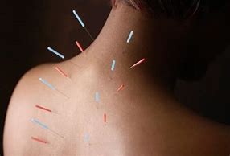
Acupuncture
Acupuncture involves the insertion of very thin needles through your skin at strategic points on your body. A key component of traditional Chinese medicine, acupuncture is most commonly used to treat pain. Increasingly, it is being used for overall wellness, including stress management.
Traditional Chinese medicine explains acupuncture as a technique for balancing the flow of energy or life force — known as chi or qi (chee) — believed to flow through pathways (meridians) in your body. By inserting needles into specific points along these meridians, acupuncture practitioners believe that your energy flow will re-balance.
In contrast, many Western practitioners view the acupuncture points as places to stimulate nerves, muscles and connective tissue. Some believe that this stimulation boosts your body's natural painkillers.
Why it's done
Acupuncture is used mainly to relieve discomfort associated with a variety of diseases and conditions, including:
  Chemotherapy-induced and postoperative nausea and vomiting
  Dental pain
  Headaches, including tension headaches and migraines
  Labor pain
  Low back pain
  Neck pain
  Osteoarthritis
  Menstrual cramps
  Respiratory disorders, such as allergic rhinitis
  https://www.mayoclinic.org/tests-procedures/acupuncture/about/pac-20392763

Slide 17
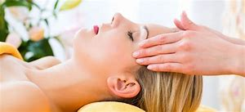
Healing Touch
Healing Touch is a relaxing, nurturing, heart-centered energy therapy that uses gentle, intentional touch that assists in balancing physical, emotional, mental, and spiritual well-being. Classified by the National Institutes of Health as a biofield therapy and nursing intervention, Healing Touch may be used to address the North American Nursing Diagnosis Association (NANDA-1) diagnosis of “Imbalanced Energy Field.”
Healing Touch is a collection of standardized, noninvasive techniques that clear, energize, and balance the human and environmental energy fields. Healing Touch assists in creating a coherent and balanced energy field, supporting one’s inherent ability to heal. It is safe for all ages and works in harmony with, is complementary to, and may be integrated with standard medical care.
Participants learn about the research basis that suggests Healing Touch is beneficial in calming anxiety and reducing symptoms of depression, decreasing pain, strengthening the immune system, enhancing recovery from surgery, complementing care for neck and spine problems, deepening spiritual connection, supporting cancer care, creating a sense of well-being, easing acute and chronic conditions, and supporting resiliency in health care providers.
https://www.healingbeyondborders.org/index.php/about/what-is-healing-touch
Watch Introduction to Healing Touch with Sue Kagel, RN, BSN, CHTP/I, HNC: https://www.youtube.com/watch?v=HhrMiMlWx4E
11 minutes
Do you think healing touch can be effective?
  Why and why not
  Would you try it?

Slide 18
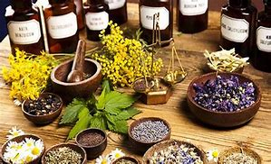
Herbal Supplements
Herbal supplements are products made from botanicals, or plants, that are used to treat diseases or to maintain health are called herbal products, botanical products, or phytomedicines. A product made from plants and used solely for internal use is called an herbal supplement.
Many prescription drugs and over-the-counter medicines are also made from plant products, but these products contain only purified ingredients and are regulated by the FDA. Herbal supplements may contain entire plants or plant parts.
Herbal supplements come in all forms: dried, chopped, powdered, capsule, or liquid, and can be used in various ways, including:
  Swallowed as pills, powders, or tinctures
  Brewed as tea
  Applied to the skin as gels, lotions, or creams
  Added to bath water
The practice of using herbal supplements dates back thousands of years. Today, the use of herbal supplements is common among American consumers. However, they are not for everyone. Because they are not subject to close scrutiny by the FDA, or other governing agencies, the use of herbal supplements remains controversial. It is best to consult your doctor about any symptoms or conditions you have and to discuss the use of herbal supplements.

Slide 19
Who benefits from CAM?
In theory, anyone. It doesn’t matter if they’re sick or healthy. Every person will respond differently to each product or practice. It’s also important to know that some complementary approaches have been studied more than others. For example, research shows that acupuncture may be helpful in fighting chronic pain, including that of the lower back and neck. It’s also been proven effective in treating pain from arthritis and different types of headaches.
Are There Risks?
Yes. That’s the case for all types of medicine, traditional Western included. But alternative medicine can be very dangerous if it’s used in place of traditional treatments. It can even be life-threatening. That’s partly because you’re not getting proven treatments for your condition.
But many forms of complementary medicine -- like meditation -- don’t have many side effects and can be used safely.
Some herbs, supplements, and vitamins also have potential side effects These substances aren’t regulated by the government in the same way that drugs are. And, although many claim to be “natural,” this doesn’t always mean they’re safe. Ingredients, dosing, and manufacturing processes can vary widely from product to product.
Here are some specific dangers linked with natural products:
  St. John’s Wort. This herb is used to treat depression. But it can reduce how effective some drugs are. Among these are certain cancer medications, immunosuppressants, and antiretrovirals.
  Kava Kava. Some people use this herb to ease anxiety. But it may cause liver damage.
  Vitamin C. If you take this in high doses, it could affect how well chemotherapy and radiation work in treating cancer.
  Herbal Products Used in Chinese Medicine. Some of these may contain heavy metals, like lead or arsenic.
  Dietary Supplements. These can interfere with different cancer treatments. For instance, some of them might cause your skin to become sensitive if you take them while getting radiation. This is one reason why oncologists usually tell you to avoid taking them if you’re undergoing treatment.
  Chiropractic Treatment. In very rare cases where this natural therapy has been used on the spine, it’s ended in a stroke. More common side effects, like headaches, are mild and don’t last long.
  https://www.webmd.com/balance/guide/complementary-vs-alternative-medicine#1

Slide 20
Unit Reflection
In pairs, list as many complementary and alternative treatments as you can, whether or not they have been covered today.
Write a brief description of each.
Which do you think you may try and under what circumstances?
Class discussion to the extent students are willing to share.

